Slide 1
Solid waste management using optimal path and autonomous bin.
Projected by
Team confidential
Team member-
1.Ritik 19245
2.pushpendra dhakar 19229
3. Shubham latpate 19181

Slide 2
Motivation:
1.Heavy expenses on collection and transportation.
2. Inaccessible places.
3. Mismanagement in collection of waste .

Slide 3
Research Gap:
Current research :
A . optimisation using sensory data .
B. optimisation using historical data.
Autonomous collection.

Slide 4
Problem definition :
Single truck collection problem.
Consumes more time.
More fuel.

Slide 5
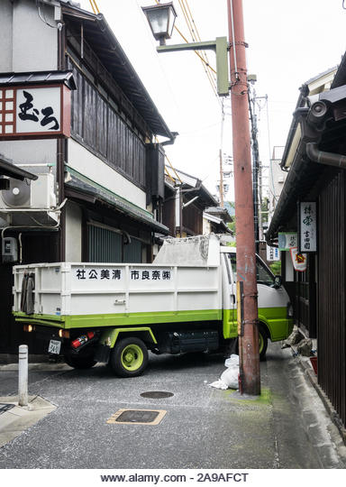
Problem Definition -
Inaccessibility of pick-up van in small streets (causing traffic jams).

Slide 6
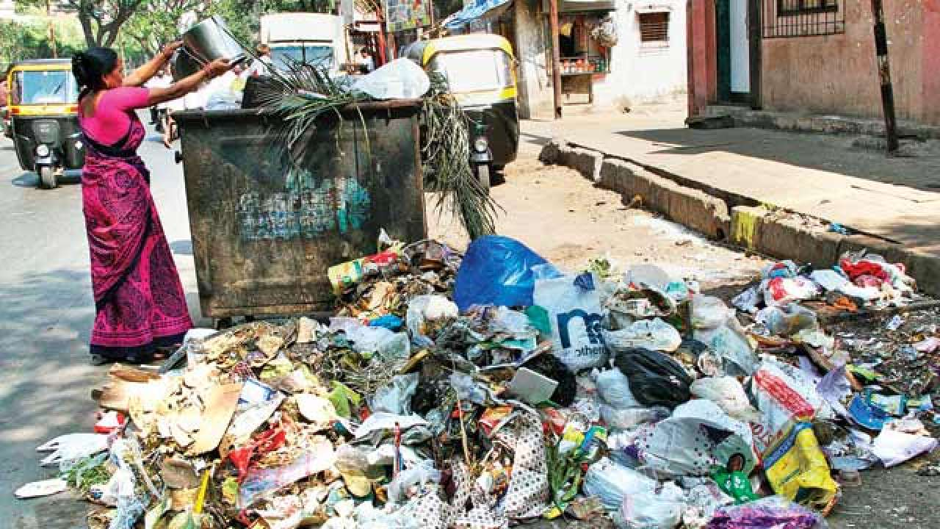
Problem definition :
Lack of information transfer between households and dustbins.

Slide 7
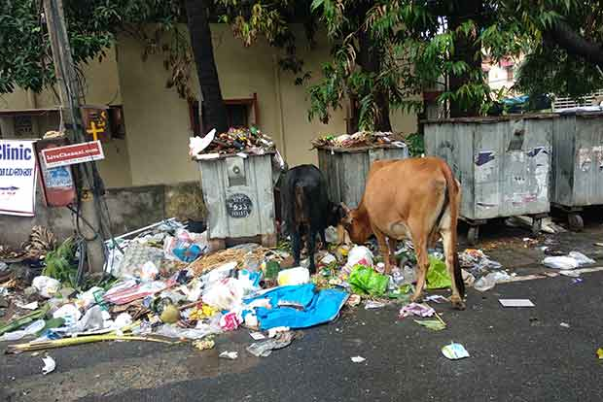
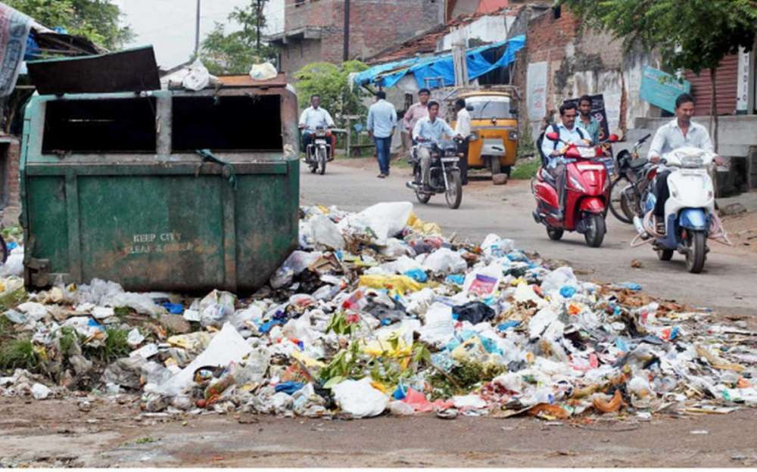
Problem definition
Overflowing of dustbins and collection of waste around them.

Slide 8
Assumptions
Data for collection from household.
Bin will be well equipped with sensors.

Slide 9
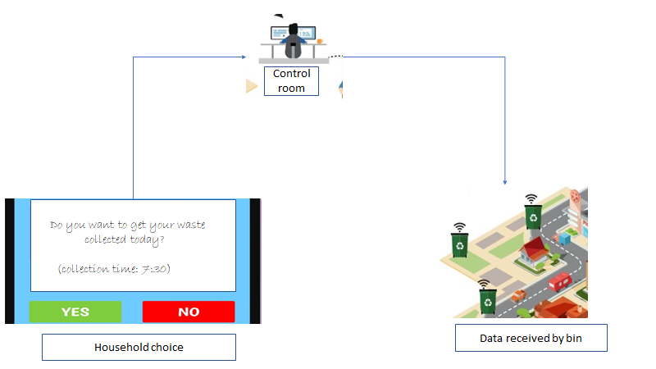

Slide 10
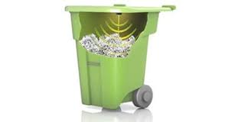
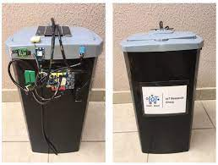
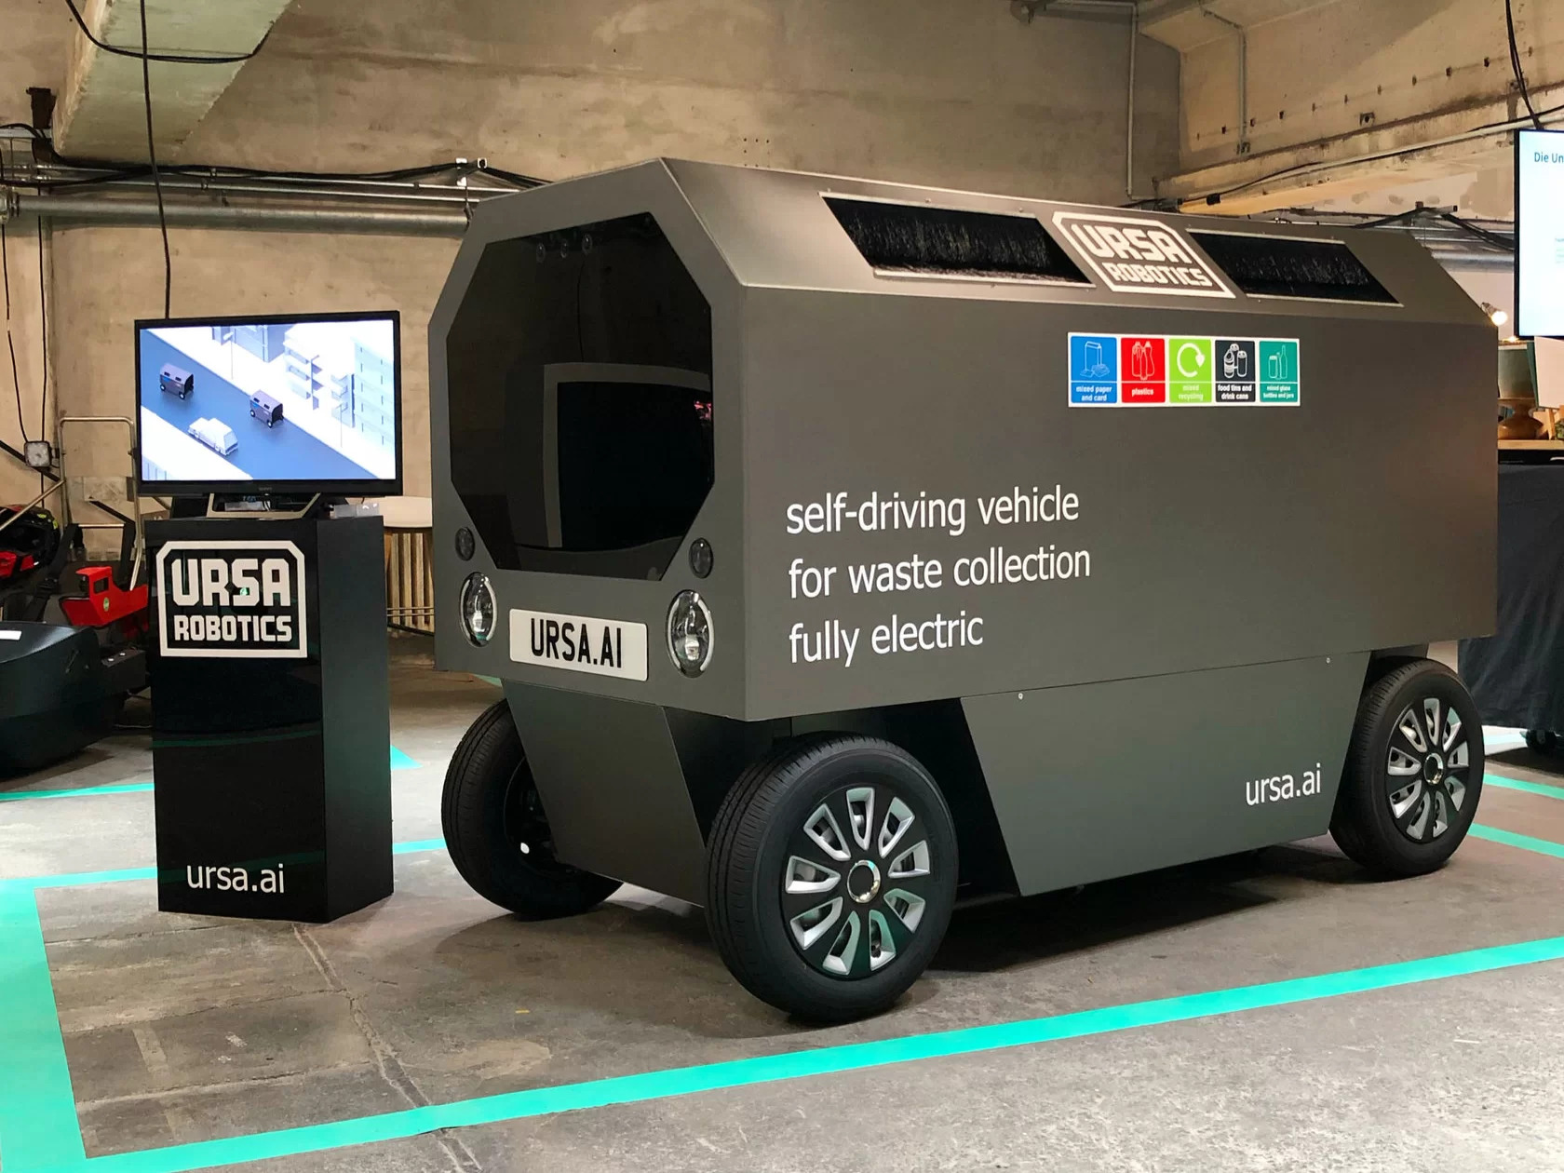

Slide 11
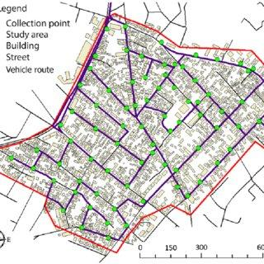
Contributions -
A different approach -
Using autonomous Bins-

Slide 12
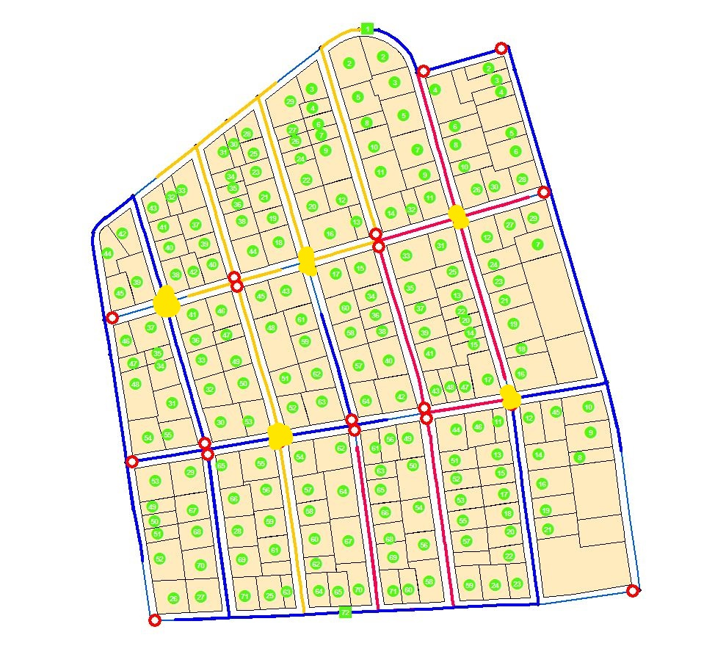
Contributions -

Slide 13
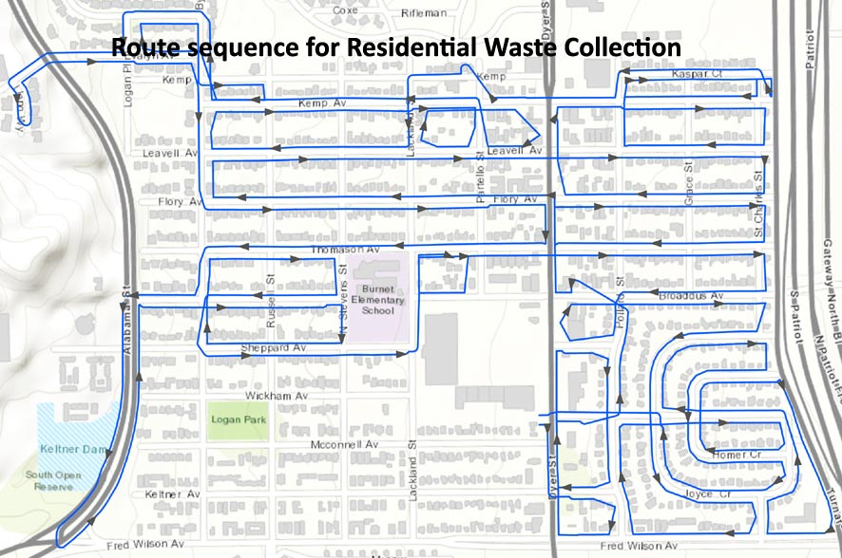
Objectives -
We develop algorithm to -
Make dustbins capable of planning optimal path.

Slide 14
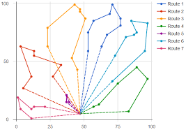
Objectives -
Optimal path planning for pick-up trucks.

Slide 15
Objectives -
Make waste collection from household completely autonomous.
Make environment through simulation and test the algorithms.

Slide 16
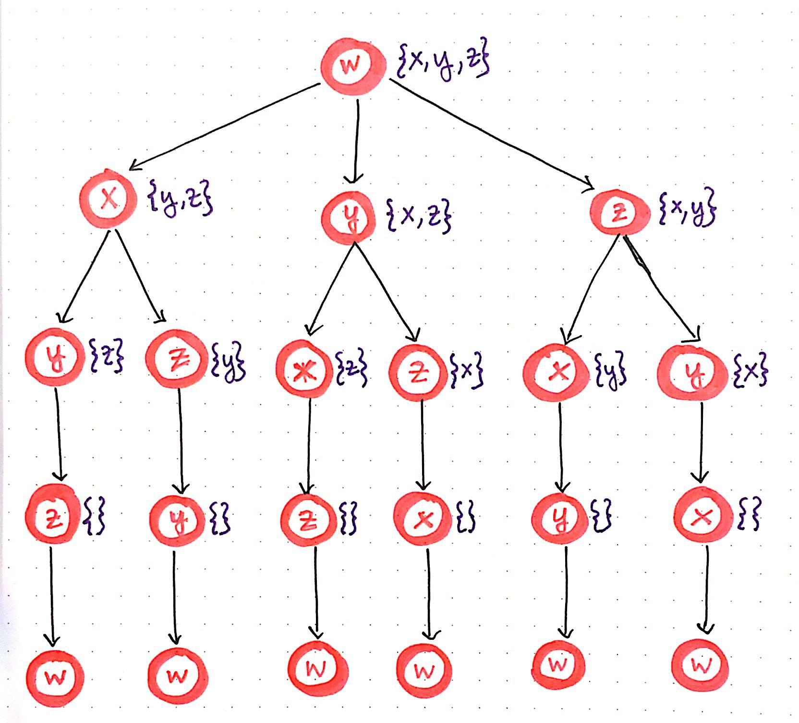
Proposed methodology -
Path Optimization -
Bellman-held-karp algorithm (Dynamic programming)
For path optimization of dustbins.
Our last node will be initial point of the dustbin and second last node will be the location of pick-up truck.

Slide 17
Proposed Methodology -
Genetic algorithm for MVRP.
For path optimization of pick-up trucks.

Slide 18
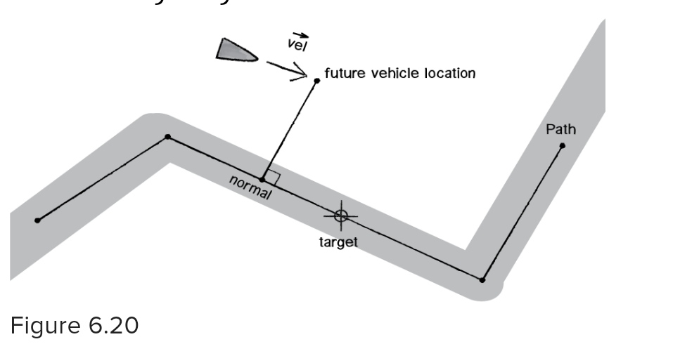
2) Path following for bins:
(craig-reynolds steering behaviour)

Slide 19
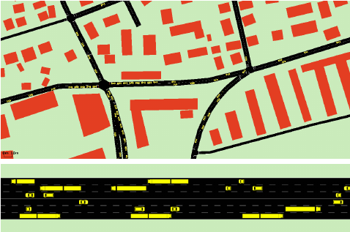
3) Simulation
Pygame module to create simulation of roads and buildings

Slide 20
Possible results -
Collection and transportation of waste with significant reduction in costs, efforts and improving ease-of-living.
Waste collection from household with autonomous bins.
The autonomous bin will follow optimal path covering multiple households.
Pickup truck collecting waste from dustbins will also follow optimal path.

